Slide 1
Microsoft News
Neural News Recommendation with Topic-Aware News Representation
Neural News Recommendation with Attentive Multi-View Learning
NPA: Neural News Recommendation with Personalized Attention

Slide 2
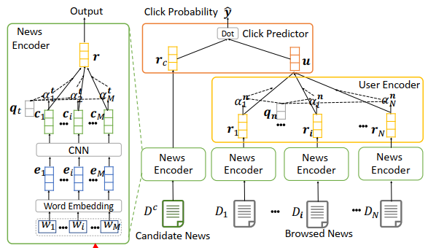
Neural News Recommendation with Topic-Aware News Representation

Slide 3
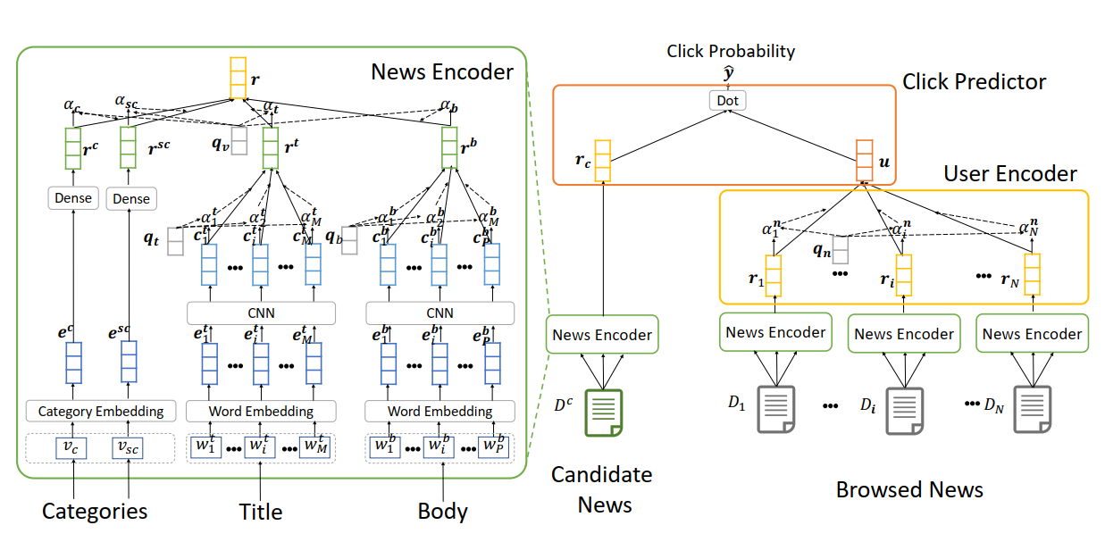
Neural News Recommendation with Attentive Multi-View Learning

Slide 4
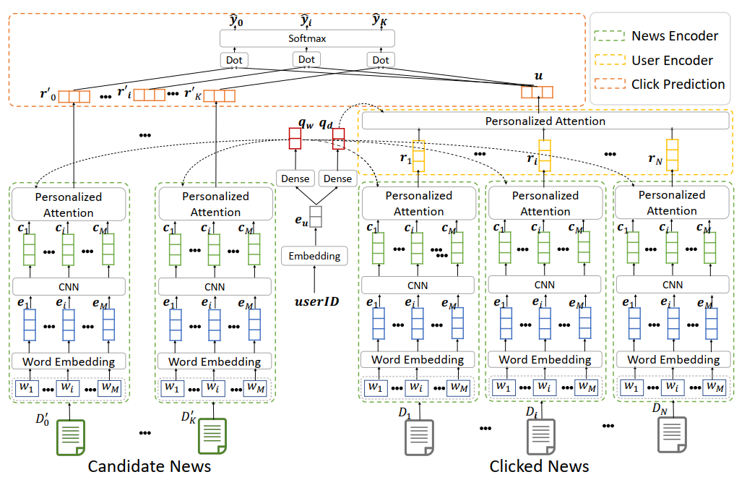
NPA: Neural News Recommendation with Personalized Attention

Slide 5

